Slide 1
Flipkart project

Slide 2
Submission
ipynb file

Slide 3
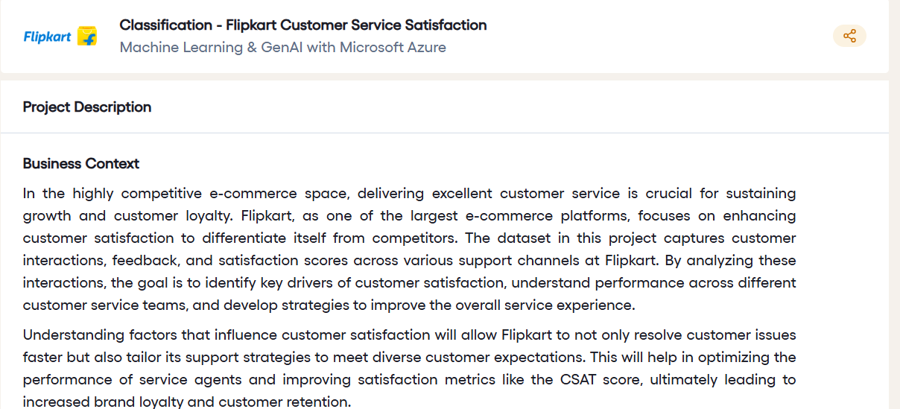

Slide 4
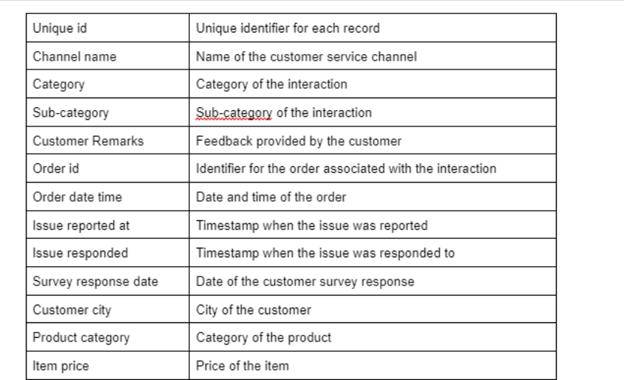

Slide 5
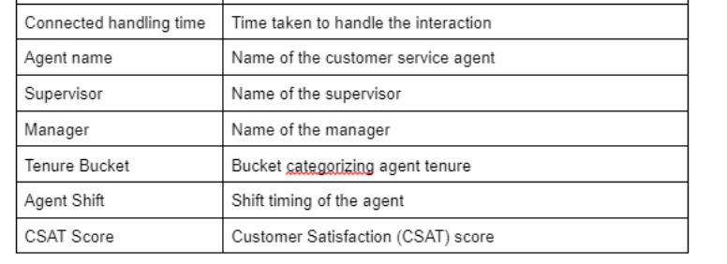

Slide 6


Slide 7
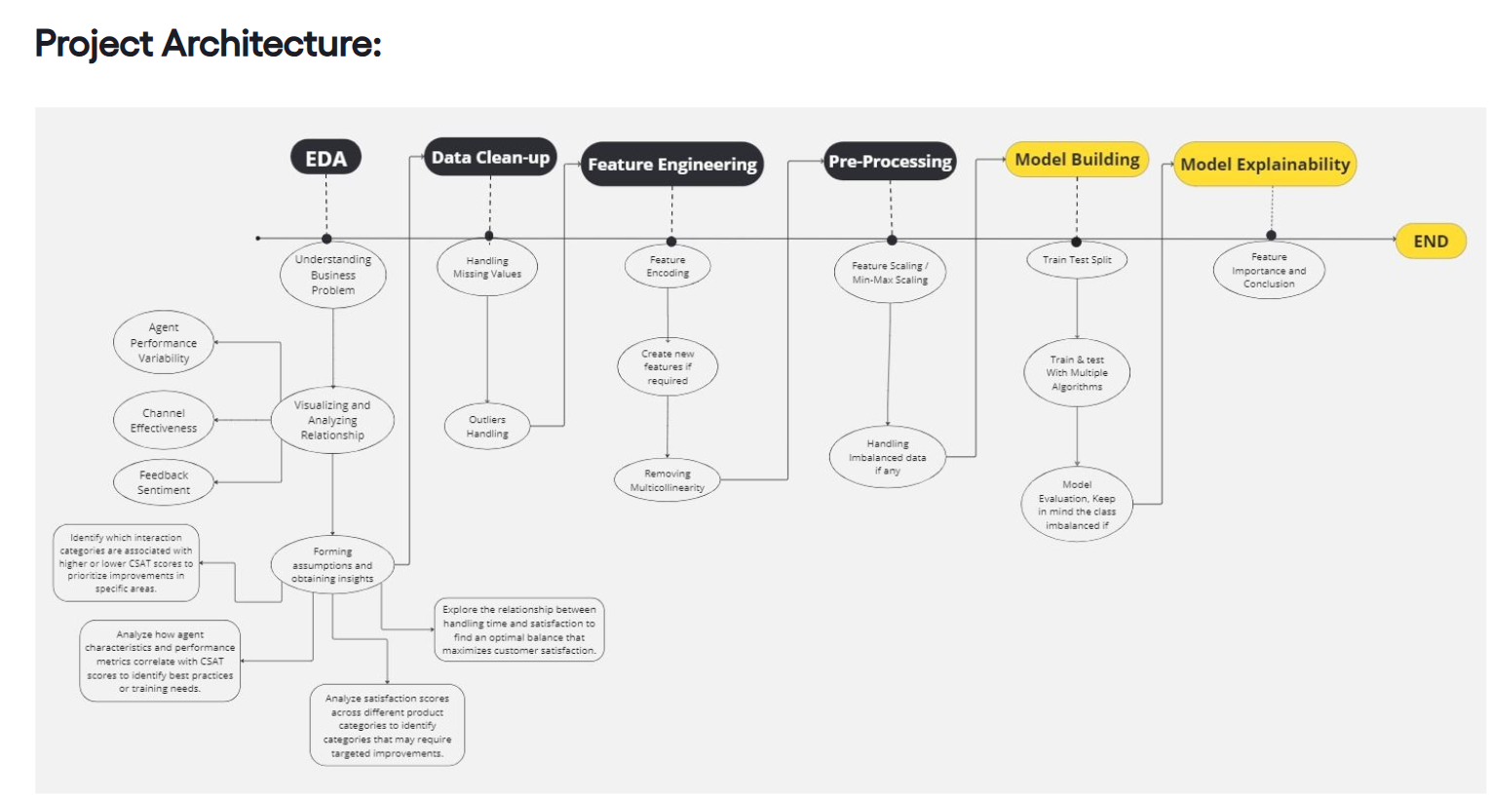

Slide 8
